Slide 1
Automated Car Parking System
Group No: 06

Slide 2
Group Members
Sharuka Thirimanne BSC/EE/2016/02/0009
Chamil Weerasinghe BSC/EE/2016/02/0002
Harsha Weerasinghe BSC/EE/2016/02/0025
Uminda Karunarathne BSC/EE/2016/02/0014
Nadeeshika Weerasinghe BSC/EE/2016/02/0072
Lanka Dissanayake BSC/EE/2016/02/0054

Slide 3
Introduction – Automated Car Parking System
Solution to manage the parking system by indicating vacant parking slots
Using software solutions combining with electronic components
From this kind of a system, parking will be an easy and secured for both customer and staff.

Slide 4
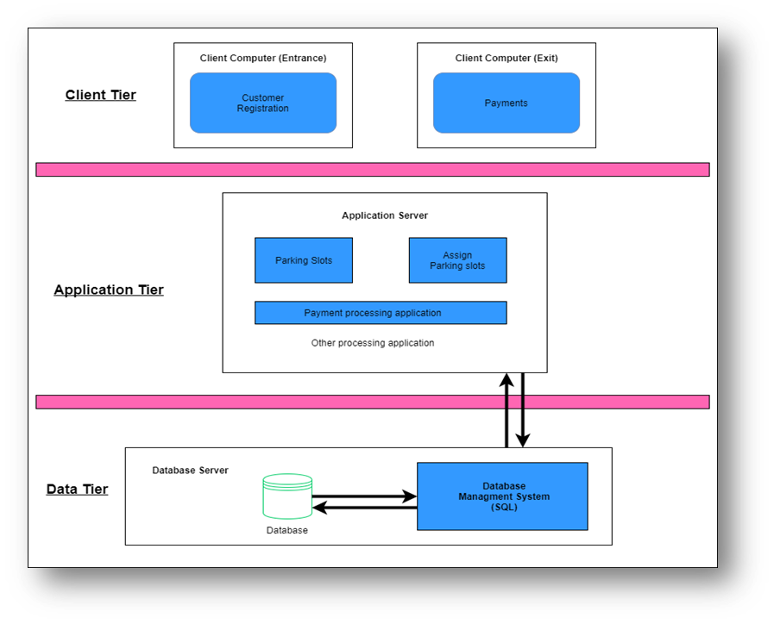
Architecture & Solution
Using software solutions combining with electronic components

Slide 5
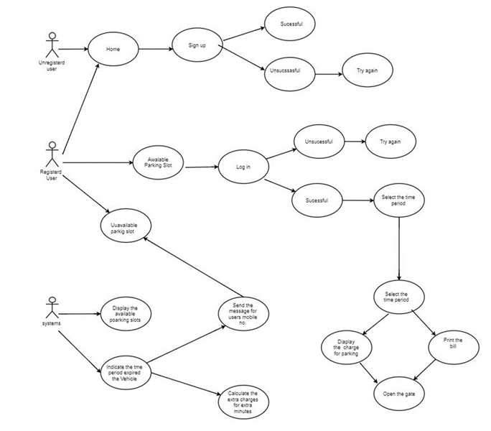

Slide 6
Demonstration

Slide 7
Marketing Valuable features
Require less manpower.
No wastage of time.
The system is secured.
Keep all records properly and easy to identify the person and his details.
Customer can see whether there is vacant slots before entering to the car park.
If customer exceeds his booked time period an automatically email will be sent to the customer and at last total cost add in bill.

Slide 8
Questions & Answers

Slide 9
Thank you !

